Slide 1
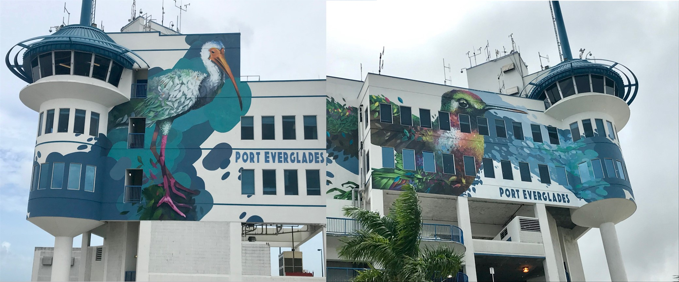
Environmental Stewardship Through Public Art
Entry Classification: #6
Category: 3

Slide 2
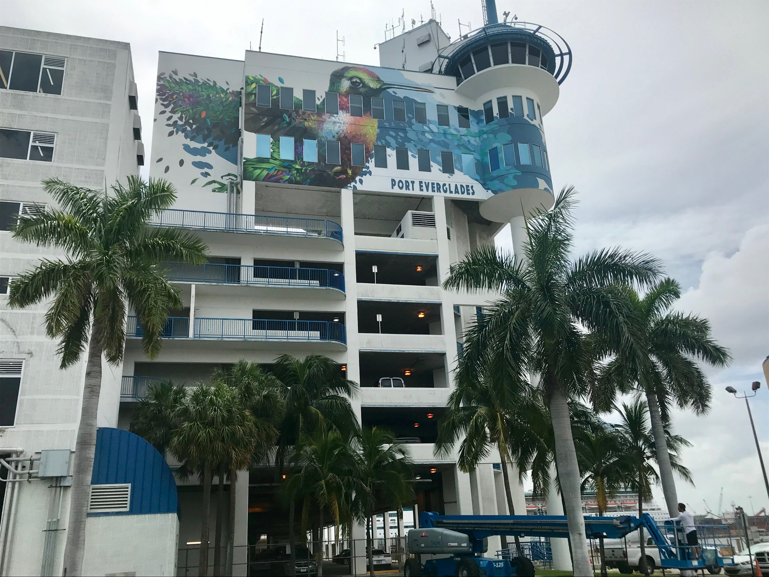
Summary
Public art is important to Port Everglades because it’s a window into the soul of the people of Broward County and our community at large. The Port communicates with its customers, residents and visitors in part through public art.
The Port’s customers see art as a front door into their business --meaning that the Port uses public art to create a positive first impression, a visual “welcome into our port” message. The community takes pride that 4 million annual Port visitors associate all of Broward County, FL with the Port’s use of art to express a commitment to extraordinary hospitality. Community art creates attachment to one’s community.

Slide 3
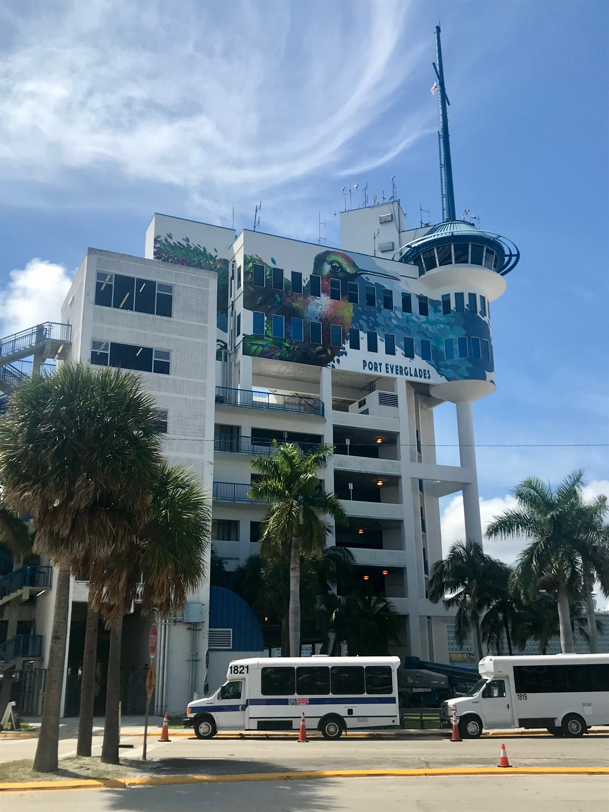
Summary
The vividly colored mural nine stories high on the Port’s iconic Harbormaster Tower was painted by Ernesto Maranje. He was selected not only because of his esteemed reputation in the public art space, but also because the birds that Maranje chose to display, the Ruby Throated Hummingbird and the American White Ibis, are native birds to Broward County and convey an environmentally impactful message.
The mural not only represents our connection between art and the community, but it also demonstrates Port Everglades’ dedication to environmental stewardship. This mural is highly visible to visitors, cruise guests, port workers, the thousands of boaters that pass by every day along the Intracoastal Waterway, and residents who live within view of Port Everglades. It serves as an inspired welcome mat to all who visit Broward County. This is truly a sense of community pride.
The theme of the mural is: “The freedom to arrive, navigate and escape to any desired destination. Creating a place of paradise for migrating visitors and locals.”

Slide 4
Challenges & Opportunities
CHALLENGES:
As the Greater Fort Lauderdale region becomes more populated and urbanized every year, the need to promote the natural habitat increases. Our concept for public art is to focus exclusively on displaying native flora and fauna to represent our community to the world. Art is displayed in highly visible places throughout Port Everglades such as at security checkpoints and the Port’s cruise terminals.
OPPORTUNITIES:
The artwork sends a message to the public that we care not just about moving them through the Port, but also providing something that the public can enjoy while they are on the property. We encourage visitors to help amplify our message by taking pictures to share with family, friends and share on their social media platforms.
For local boaters, the mural creates a sense of pride and communicates our commitment to environmental stewardship.

Slide 5
Goals & Objectives
GOALS:
Create a welcoming impression for our visitors and cruise guests
Raise awareness of the Florida Everglades’ protection and preservation
Convey the message that Port Everglades is not just an industrial facility
OBJECTIVES:
Soften the Port’s industrial hard edge
Create a positive first impression, a visual “welcome into our port” message
Showcase the Port’s environmental stewardship
Add to Broward County’s cultural landscape
Create a social media photo-op for boaters and cruisers
Heighten the sense of community surrounding the Port

Slide 6
Mission Statement
The messages about this program is relate to our mission statement.
Port Everglades is Florida’s powerhouse global gateway. A respected leader in trade, travel and financial stability, we create economic and social value by working in partnership with world-class clients. We achieve advancements focusing on efficient facilities, trade and cruise expansion, jobs growth, safety, security and environmental stewardship for our customers, stakeholders and community.

Slide 7
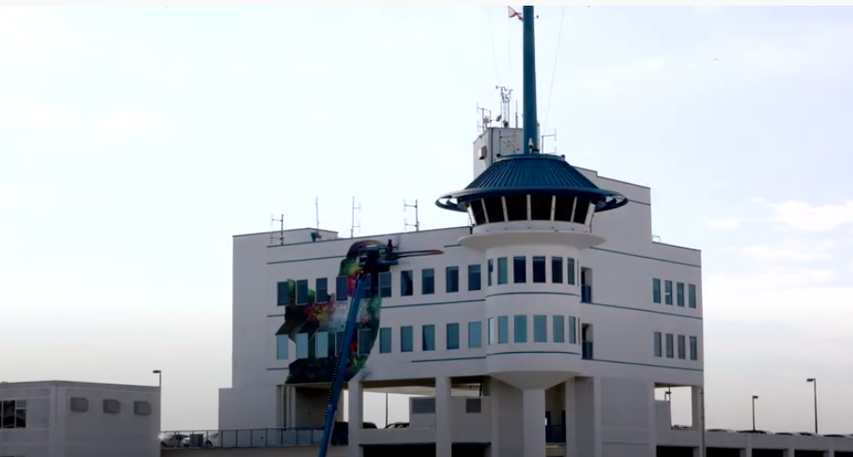
Strategies & Output
A layered approach was taken to select the public art, which includes defining the vision, intended site and set budget.
A mural on the Harbormaster Tower was determined to be the way to celebrate the Port’s 90th anniversary.
The art community was solicited to apprise them of the opportunity.
Various committees of local artists and community members, under the guidance of the Broward County Cultural Division, convened to review proposals, vet artists and ultimately mate an artist to the project.
The artistic proposal was refined and then approved by the Port followed by the commission being offered to the artist.

Slide 8
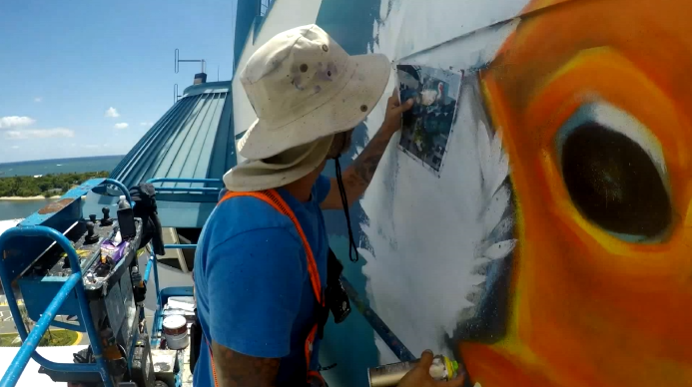
Strategies & Output
Ernesto Maranje, a local painter, illustrator and muralist who discovered his passion for art while serving in the U.S. Coast Guard, was selected.
Equal to the Port’s commitment to public art is its commitment to the local environment. Maranje worked with the Port’s environmental management team to select the Ruby Throated Hummingbird and the American White Ibis, both native Florida birds, to be featured in the mural.

Slide 9
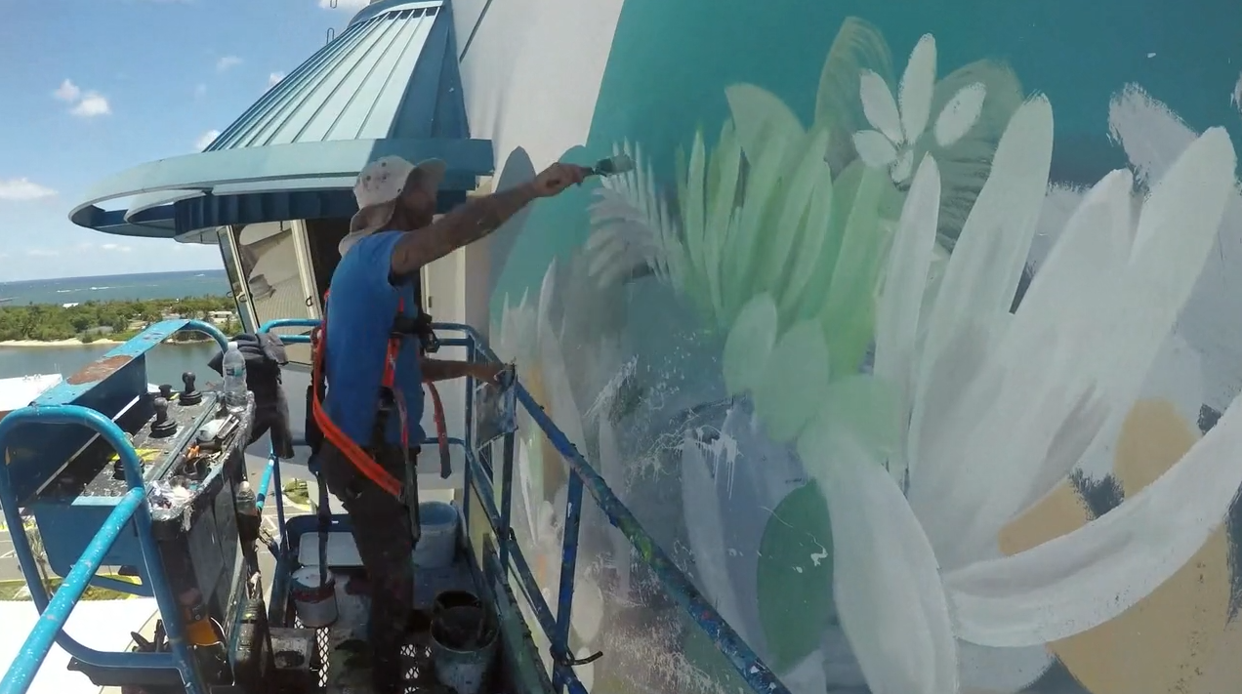
Strategies & Output
Maranje uses his vivid imagination to portray the unity of animals and plants by pulling different segments from each and creatively making it cohesive. The results are not only pleasing to the eye, but also remind us of the connection we have with nature. His message is especially significant today with the emphasis on protecting the Florida Everglades, the Port’s namesake. The colors and vibrancy are exciting and reflect the energy of the Port and the community at large.

Slide 10
Expenditures & Assets
The Public Art & Design Program was established by Broward County Government to created an enhanced visual environment for residents as well as promote tourism and economic vitality through artistic design of public places. Two percent of a Broward County capital improvement project budget is allocated to public art construction or renovation of any building.
The total cost for the Harbormaster Tower mural was $90,000 with a $5,000 contingency fee. The artist was paid in five installments based on completion of milestones.
Estimated Artwork Production Cost
Lifts | $9,500
Paint/Latex (Bear Marquee) Exterior | $3,000
Spray cans/ Montana Gold & Black | $2,000
Lighting and Installation | $9,000
Transportation | $1,200
Storage rental – 30 days | $1,500
Per Diem | $3,000
Artist, Team and Design fee | $50,000
Insurance | $6,000
Materials and supplies | $1,500
Project management | $2,500
Legal | $750
Estimated total investment | $89,950

Slide 11
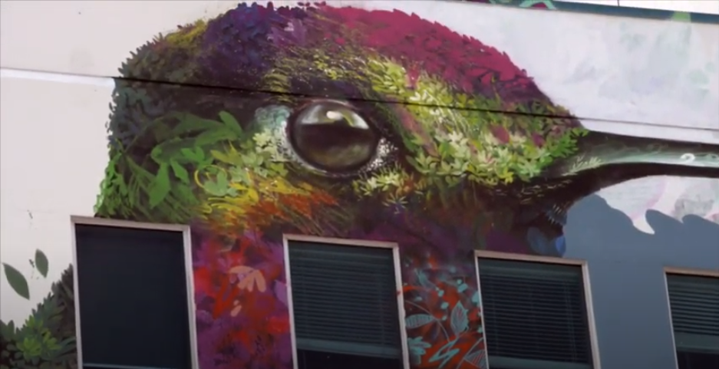
Results
Annually, the Harbormaster Tower murals are seen by approximately 4 million cruise passengers and the thousands of pleasure boaters who pass by the Port as they sail along the Intracoastal Waterway. It is also now used as a navigation aide for both boaters and civilian pilots.
A documentary about the piece generated 274 organic views on YouTube. In addition, a series of time-lapse videos of the artist’s progress in creating the mural generated approximately 6,000 views on Facebook.
Documentary Link
https://www.youtube.com/watch?v=VzSSpaUs7Mo
Time-Lapse Video
https://www.youtube.com/watch?v=sC3yGVNW9J4

Slide 12
Results
Communications Tools
Mural Documentary
https://www.youtube.com/watch?v=VzSSpaUs7Mo
Mural Time-Lapse Video
https://www.youtube.com/watch?v=sC3yGVNW9J4
Port Everglades Website
https://www.porteverglades.net/stewardship/public-art/
Broward County Cultural Division Website
https://www.broward.org/Arts/PublicArt/Pages/Artwork.aspx?artwork=1472

Slide 13
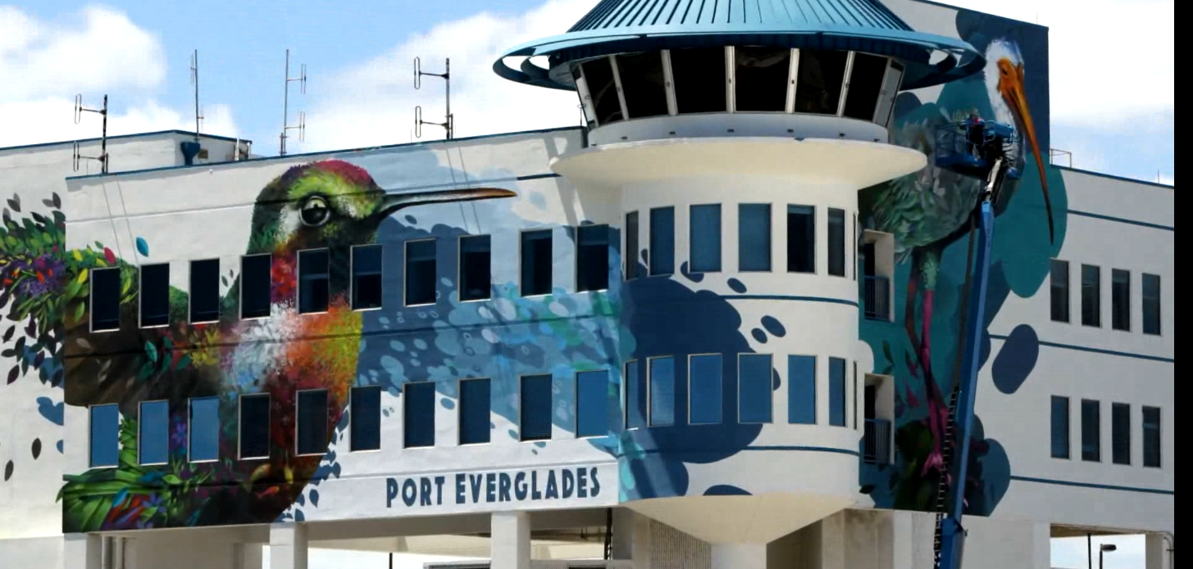
Results
Comments heard from our guests in the documentary produced for community outreach purposes accurately demonstrate the success of the piece at Port Everglades. “It is absolutely gorgeous. I could tell it was a hummingbird.” “It’s just colorful, pretty…It doesn’t look like a parking garage.”
The Broward County Public Art & Design Program is recognized with distinction in national and international circles. “The program is a national leader in developing model public art policies and best practices, producing exemplary public artwork synthesizing design and excellence. Broward County has received five Americans for the Arts Year in Review public art awards, as an indicator of the program’s outstanding commitment to advancing art and design,” said Liesel Fenner ASLA, former manager of the Public Art Network for the Americans for the Arts.

Slide 14
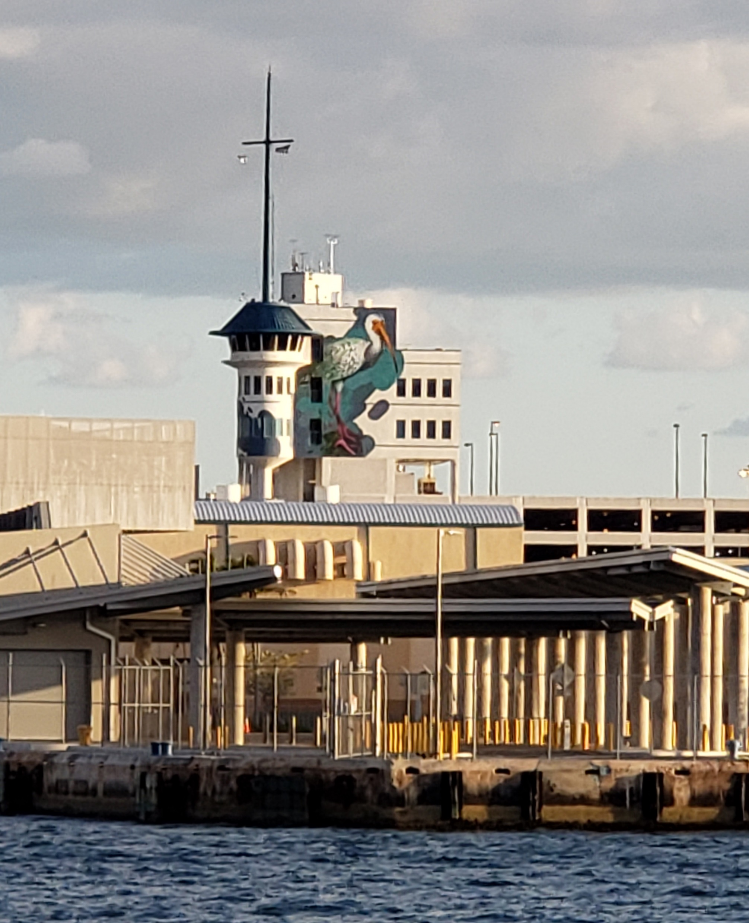
Conclusion
The Harbormaster Tower Mural creates a sense of place and home. The work welcomes visitors with local nesting birds set in a vibrant setting akin to the Florida Everglades itself. The birds also represent those who visit and live in the community as well as the experiences that everyone can share as part of the community. The expansive piece spans multiple buildings and represents the vastness and complexity of the Everglades region, a region that has an ecology like no other in the world. The Florida Everglades is important to our community identity.
Members of the community know the necessity of raising daily awareness of Everglades protection and preservation as we look to the future. This mural furthers that mission. The typography of the mural exudes the natural habitat, highlighting the water, sun, and delicate nature of the landscape. The whimsical, colorful figures are inviting to those of all ages and creates a sense of magic for this special community.

