Slide 1
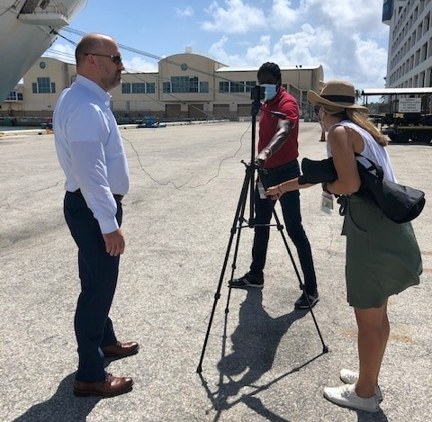
Stay Connected with Port Everglades
Port Everglades
Entry Classification: #10 Social Media
Category 3

Slide 2
Summary
During the first half of its fiscal year October 1, 2019 through March 14, 2020, Port Everglades welcomed a record number of cruise passengers. Already the world’s third busiest cruise homeport with approximately 3.8 million passengers traveling annually, the Port’s cruise services team was logging long hours during the busy spring break cruise season when the Coronavirus pandemic abruptly shut down cruising. Suddenly, the record year became one of the worst in decades. The Cruise staff, part of the Port Everglades Business Development Division, had much more time on their hands.
The pandemic also crushed the Communications team’s dreams of creating a new position dedicated to social media and digital marketing. Worsening matters, a hiring freeze went into effect and Communications was prohibited from replacing a long-time staffer who retired. Communications staff, also part of the Business Development Division, felt stretched as they missed social media opportunities that could be a simple, cost-effective way to engage a restless audience quarantined at home.
Problem solved! The Business Development Division, which also includes Cargo Marketing, rallied together and quickly became a social media team with the Cruise and Cargo staff acting as reporters, photographers and videographers, and the Communications staff servicing as editors and administrators.

Slide 3
Challenges & Opportunities
CHALLENGES:
How to increase social media content, and the resulting public engagement, with limited staff and resources.
How to train Cruise staff to see the Port through different lens so they can recognize social media opportunities in cargo, energy, real estate, and environmental stewardship.
OPPORTUNITIES:
Fill vacancies with seasoned Port professionals.
Improve morale by creating challenges and closing the gap on missed opportunities.
Unite the Business Development Division as the Cruise, Cargo and Communications sections worked together daily to create social media content.

Slide 4
Goals & Objectives
GOALS:
Increase public engagement through social media.
Create a team spirit in the Business Development Division where everyone participated to reach the same goal.
OBJECTIVES:
Create more content on social media
Create a buzz about Port Everglades using social media
Celebrate the port’s accomplishments
Showcase our world-class customers and their accomplishments
Garner attention for the Port’s infrastructure investments, economic impact and environmental stewardship

Slide 5
Mission Statement
The messages in our social media posts directly relate to our mission statement.
Port Everglades is Florida’s powerhouse global gateway. A respected leader in trade, travel and financial stability, we create economic and social value by working in partnership with world-class clients. We achieve advancements focusing on efficient facilities, trade and cruise expansion, jobs growth, safety, security and environmental stewardship for our customers, stakeholders and community.

Slide 6
Strategy & Outputs
Identify social media strengths – who was most familiar with Facebook, Instagram, Twitter, LinkedIn, YouTube
Establish a protocol for content creation, approvals and posting
Cross-train staff in all social media platforms
Invest time in education, without investing dollars. Staff took advantage of tutorials offered on YouTube and by the various social media platforms
Supply staff with necessary tools. We all have Smart phones with cameras, but we also needed microphones, a tripod, a ring light, graphic design software.
Our communications staffer with the drone license, worked directly with the Federal Aviation Administration (FAA) to develop a rapid approval process to use the drone as the Port is located within five miles of the Airport.

Slide 7
Strategy & Outputs
Social media became a topic at our daily virtual staff meetings so all business sections participated with content ideas.
Staff members were assigned customers to follow on social media to like, reply or repost.
One staffer in the Cruise Marketing Section took the lead and compiled a week’s worth of known social media posts into a PowerPoint presentation for the Communications team to approve. The posts were then prescheduled for release.
Other “Pop-Up Posts” were created daily as events occurred, or if there was an interesting looking vessel in port.
We encouraged participation from people in other Port Department Divisions, our customers, those we know living on the beach and in the condominiums along the entrance channel, hoteliers on the beach, the Port Pilots, Broward Sheriff’s Office marine patrol, energy and others by including their photos and videos with a “thank you” hashtag.

Slide 8
Strategies
Using a hashtag strategy – resulted increased reach and followers (consistently using #porteverglades #cruiseporteverglades #portevergladescargo) as appropriate
Using geotags consistently with each post to engage people following locations (location “Port Everglades”)
Incorporating different types of media including time lapse videos, photo carousels and videos with music.
Now using Instagram and Facebook stories and Instagram Reels

Slide 9
Results - % increase of new followers since October 2020
Facebook 12%
Instagram 244%
LinkedIn 64%
Twitter 2%
YouTube 1%

Slide 10
Expenditures & Assets
Less than $500 was incurred to purchase microphones, a tripod, a ring light and graphic design software.
The Port Everglades Business Development Division includes 10 employees in the Communications, Cargo and Cruise sections.

Slide 11
Some Our Top Posts & Staff Picks
Platform: Facebook
Post type: time lapse video of Celebrity Silhouette
Reach: 101,520
Likes: 200
Comments: 11
Shares: 35
Link clicks: 1,400
Click arrow above to view post video with audio

Slide 12
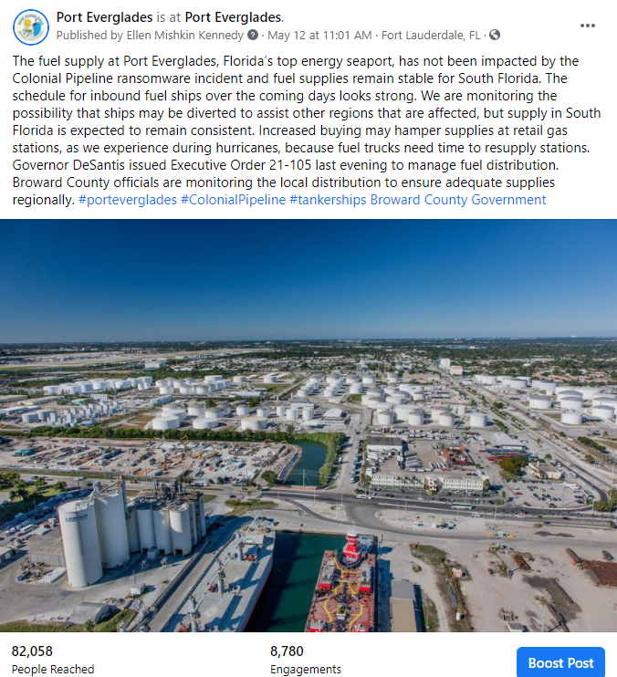
Some Our Top Posts & Staff Picks
Platform: Facebook
Post type: Statement on fuel supply
Reach: 82,058
Likes: 2,000
Comments: 524
Shares: 811
Link clicks: 5,500

Slide 13
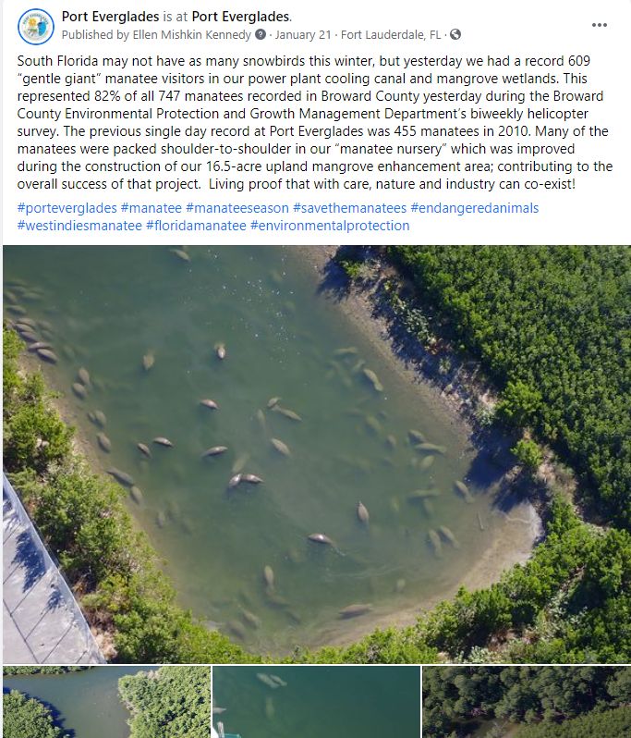
Some Our Top Posts & Staff Picks
Platform: Facebook
Post type: Report on record number of manatees
Reach: 55,043
Likes: 464
Comments: 61
Shares: 281
Link clicks: 5,900

Slide 14
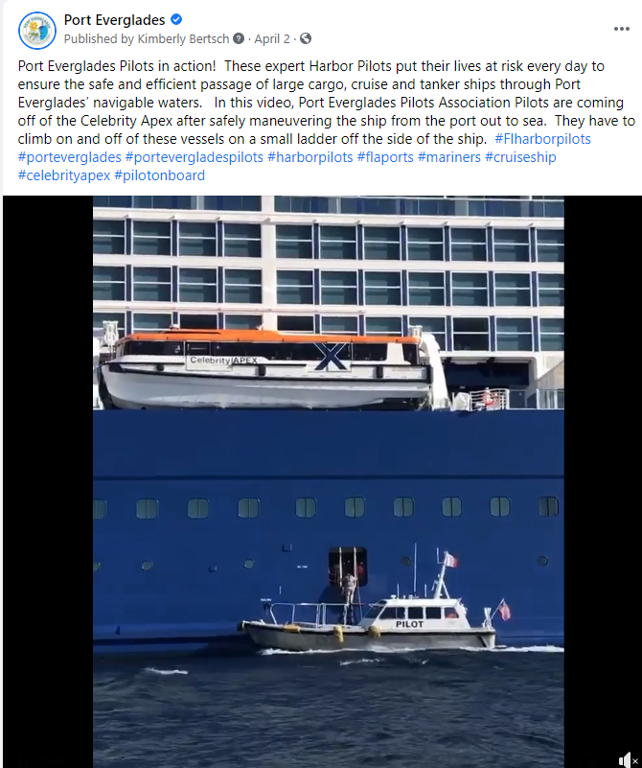
Some Our Top Posts & Staff Picks
Platform: Facebook
Post type: Video of Port Everglades Pilots disembarking Celebrity Apex
Reach: 8,812
Likes: 120
Comments: 6
Shares: 35
Link clicks: 670
Click arrow above to view post video with audio

Slide 15
Conclusion
Increased content across all of the Port’s social media platforms generated significantly more impressions to engage the public and our customers. The increased popularity of our content on social media created a buzz about Port Everglades that enabled us to celebrate the Port’s accomplishments, showcase our world-class customers and their accomplishments and garner attention for the Port’s infrastructure investments, economic impact and environmental stewardship.
In addition, but also significant, we were able to engage every staff member in the Business Development Division to help create content. This created more unity and a team spirit where everyone participated to reach the same goal.

Slide 16
Stay Connected With Port Everglades
Port Everglades
Entry Classification: #10 Social Media
Category 3
@Port.Everglades
@PortEverglades
@PortEvergladesFL
@port-everglades
@portevergladesfl

