Slide 1
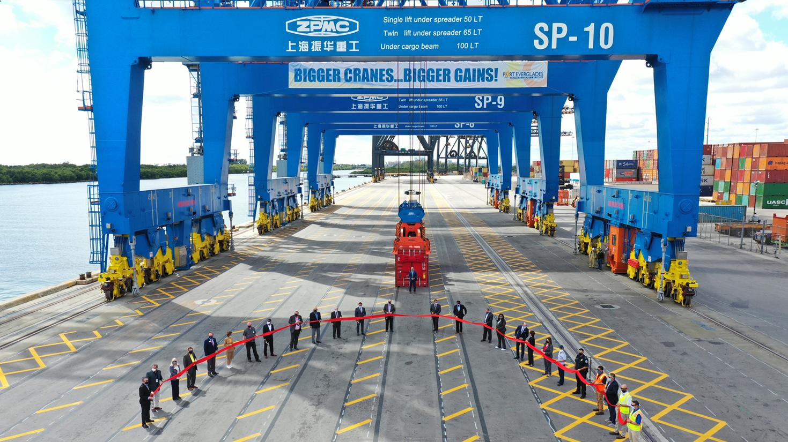
Port Everglades Crane Commissioning
Entry Classification: Special Event
Category 3

Slide 2
Summary
Port Everglades wanted to draw public attention to its major investment in three new Super Post-Panamax cranes through a celebratory event. However, due to the COVID-19 pandemic, physical participation had to be limited. To accomplish this mission, the communications team orchestrated a live-streamed event using social distancing protocols for the in-person attendees and maintained safe participation for those watching remotely. To further enhance participation, customers, business and community leaders and elected officials were invited to submit congratulatory videos that were edited together for pre-event viewing.
Forty people submitted congratulatory videos. Twenty-five people representing various stakeholder communities participated in the live ribbon-cutting event. The live-streamed event was viewed by 729 people. After the event, the Port invited stakeholders and social media viewers to watch a shorter, edited version of the congratulatory messages and the event that generated 657 views.
The Port Everglades Crane Commissioning successfully accomplished its goals of creating awareness about the Port and its critical infrastructure investments while reaching a large, broad audience of stakeholders and residents.

Slide 3
Challenge & Opportunity
CHALLENGE: How to generate excitement for this major infrastructure improvement in a COVID-19 environment.
OPPORTUNITY: Garner a much larger and broader audience using remote digital technology than we would have with a live event.

Slide 4
Goals & Objectives
GOALS:
Raise local awareness about the Port’s economic value to the community.
Garner attention in the cargo trade about the Port’s investments to improve productivity.
OBJECTIVES:
Reach a broad audience with little physical attendance
Create a buzz using social media
Honor and recognize our elected officials
Celebrate our supporters in the business community
Thank our customers for their loyalty during construction
Garner attention for the Port’s infrastructure investments

Slide 5
Mission Statement
The messages about this event clearly relate to the Port’s mission statement.
Port Everglades is Florida’s powerhouse global gateway. A respected leader in trade, travel and financial stability, we create economic and social value by working in partnership with world-class clients. We achieve advancements focusing on efficient facilities, trade and cruise expansion, jobs growth, safety, security and environmental stewardship for our customers, stakeholders and community.

Slide 6
Messages
The cranes symbolize an historic transformation taking place at Port Everglades that is changing the landscape of our community.
Port Everglades is adding new cargo berths, deepening and widening waterways, expanding cargo and rail capacity, while paying close attention to the needs of our fragile environment.
The individuals cutting the ribbon to commission our new cranes represent a cross-section of our customer base, governmental leaders and the community where we live, work and play.
What is also special about this day, is the way that the community has turned out physically and digitally to support our investments at Port Everglades.

Slide 7
Strategy & Outputs
We began generating excitement for Port Everglades’ three new Super Post-Panamax Gantry Cranes five years before the cranes arrived.
Press Releases
Port Everglades to Purchase The New Super Post-Panamax Container Gantry Cranes – June 6, 2017
New Super-sized Cranes Coming to Port Everglades June 28, 2018
Port Everglades Inspects New Super Post-Panamax Cranes November 19, 2019
World's Largest Low-Profile Ship-to-Shore Cranes Arrive at Port Everglades Nov. 17, 2020
Port Everglades Commissions New Super-Sized Cranes March 22, 2021
Social media
Speaking engagements
Media interviews
Website and all collateral print materials

Slide 8
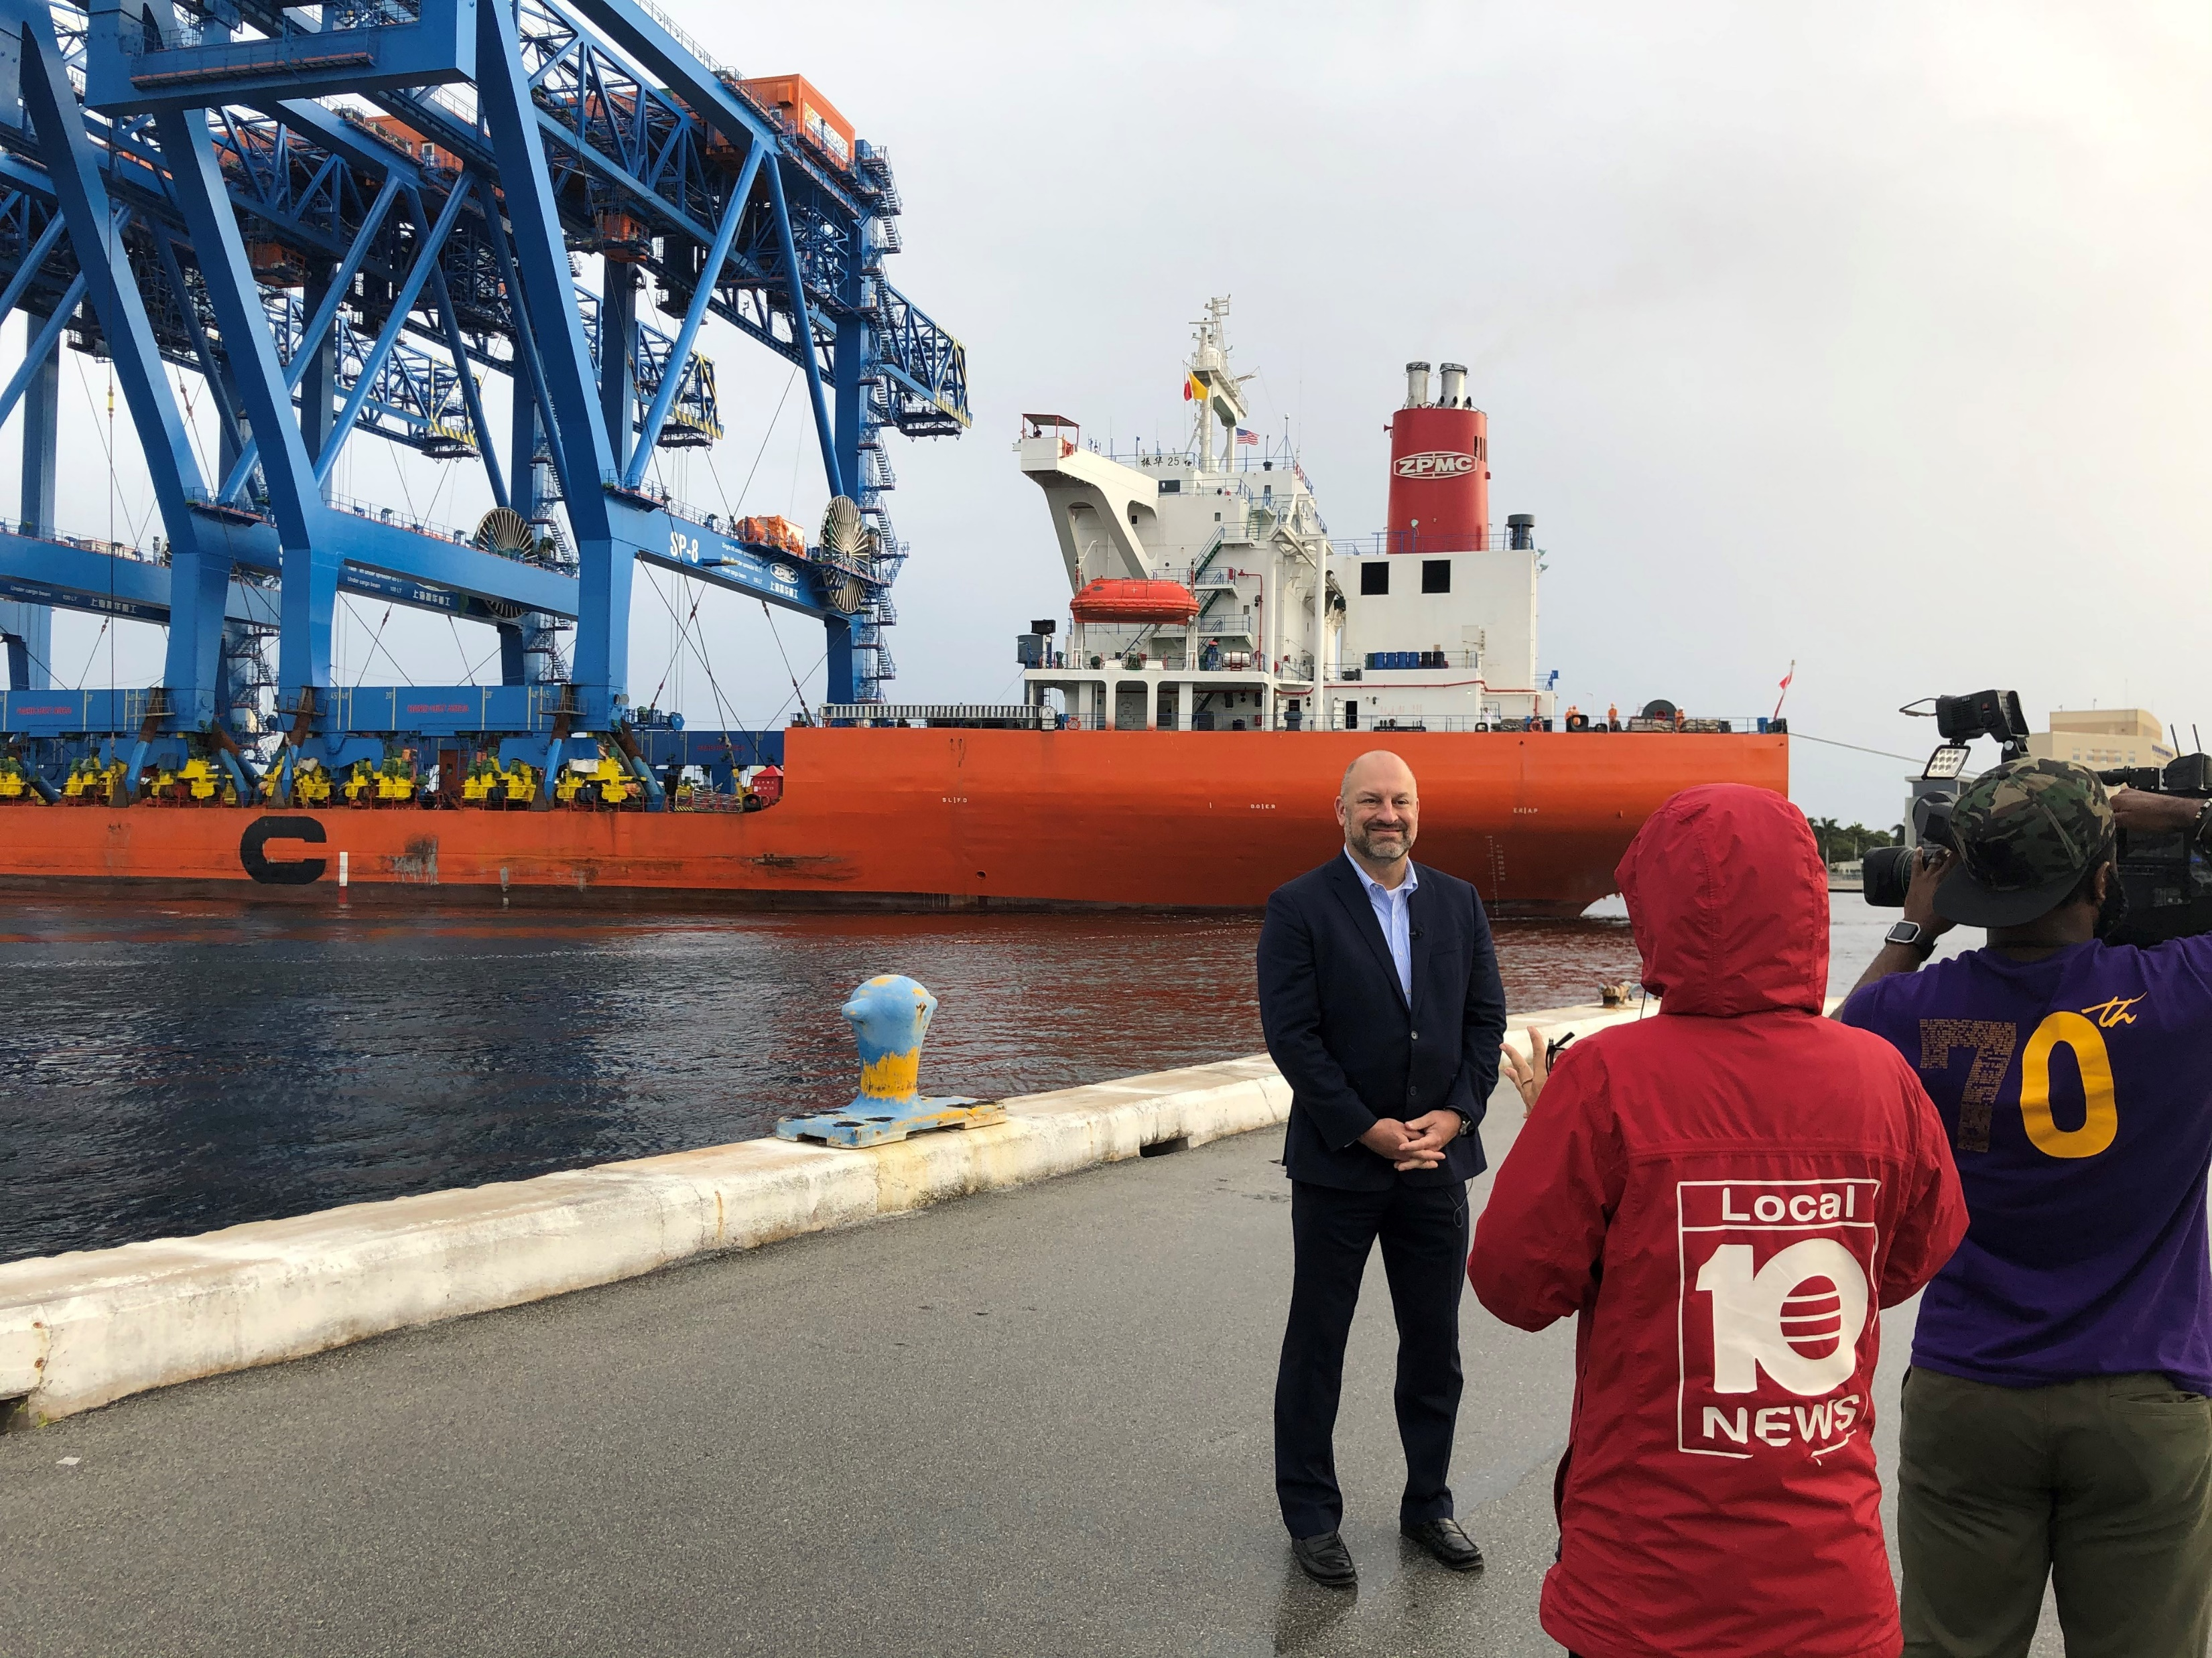
New Cranes Arrive at Port Everglades

Slide 9
Strategy & Outputs
To garner greater participation in the event, we invited those who may not feel comfortable attending in person due to COVID-19, or who were simply unavailable, to submit a 20-second video message about the new cranes.
SAMPLE INVITATION FOR VIDEO PARTICIPATION:
Dear XXXX,
You are invited be part of the virtual commissioning ceremony for our three new Super Post-Panamax gantry cranes by submitting a short video of yourself on behalf of your organization. The video will be shown as part of our virtual pre-event program on Monday, March 22 at 11:30 AM.
What you need to know:
Keep it under 20 seconds
Use a horizontal format (hold the camera sideways)
Remember to introduce yourself
Deadline is Wednesday, March 17 at 2 PM
Upload your video to this link
Be creative. Have fun and be yourself!
Our advertising agency has provided a few tips. Get Video Tips Here
For more information about our new cranes, click here.
If you have any questions, please call me directly at 954-468-3508.

Slide 10
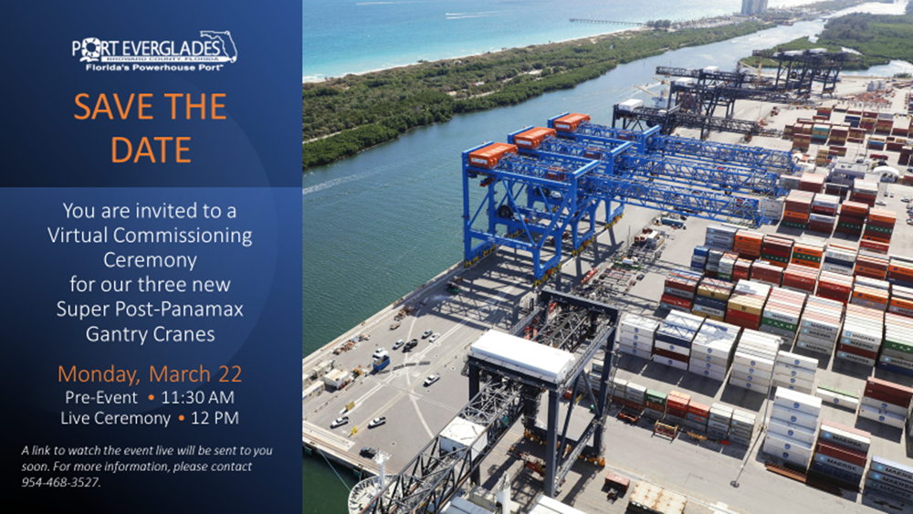
Strategies & Outputs
Save the Date emails were distributed prior to the actual invitation distribution.
The invitation with the link to the live ceremony was distributed repeatedly for two weeks prior to the event. It was also posted on Facebook, Twitter, LinkedIn and Instagram.

Slide 11
Strategies and Outputs
A cross-section of key stakeholders were invited to participate in the live ceremony. Representatives in attendance included:
• Broward County Commission (6 out of 9 Commissioners)
• Florida Department of Transportation, which helped fund the new cranes
• Mayor of the City of Hollywood, where the cranes are located
• Container terminal operators Crowley, Florida International Terminals, Port Everglades Terminals LLC, and Sun Terminals (King Ocean)
• Labor representatives
• U. S. Coast Guard
• U.S. Customs and Border Protection
• Port Everglades Association
• Greater Fort Lauderdale Alliance
• Port Everglades Action Team
• ZPMC (crane manufacturer), Liftech (crane installer), GFC (crane operator/maintenance)

Slide 12
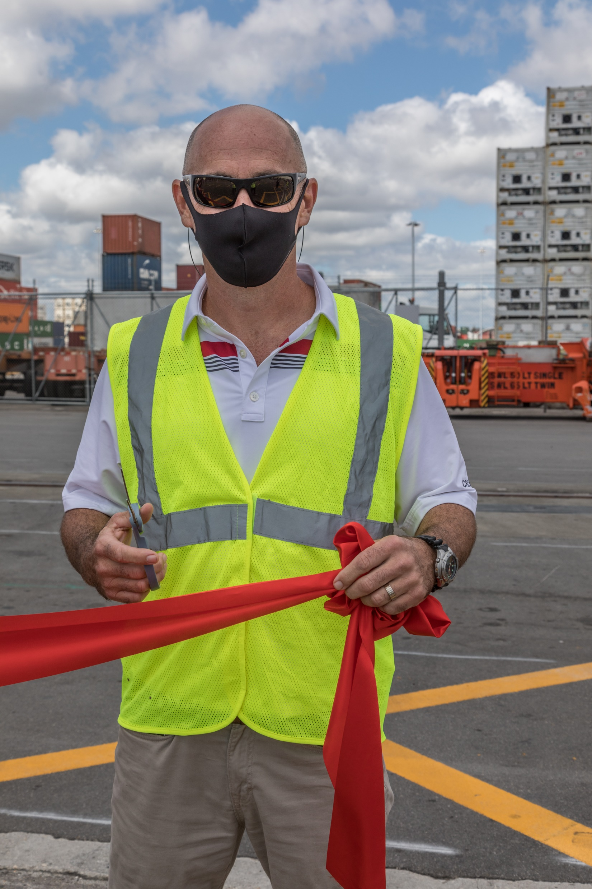
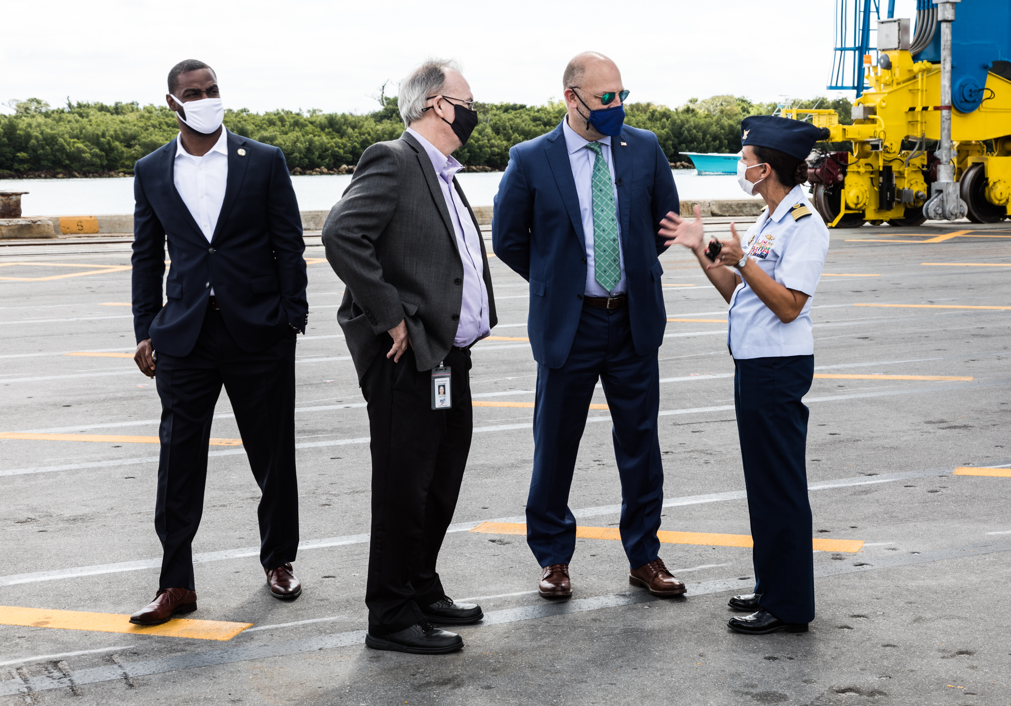
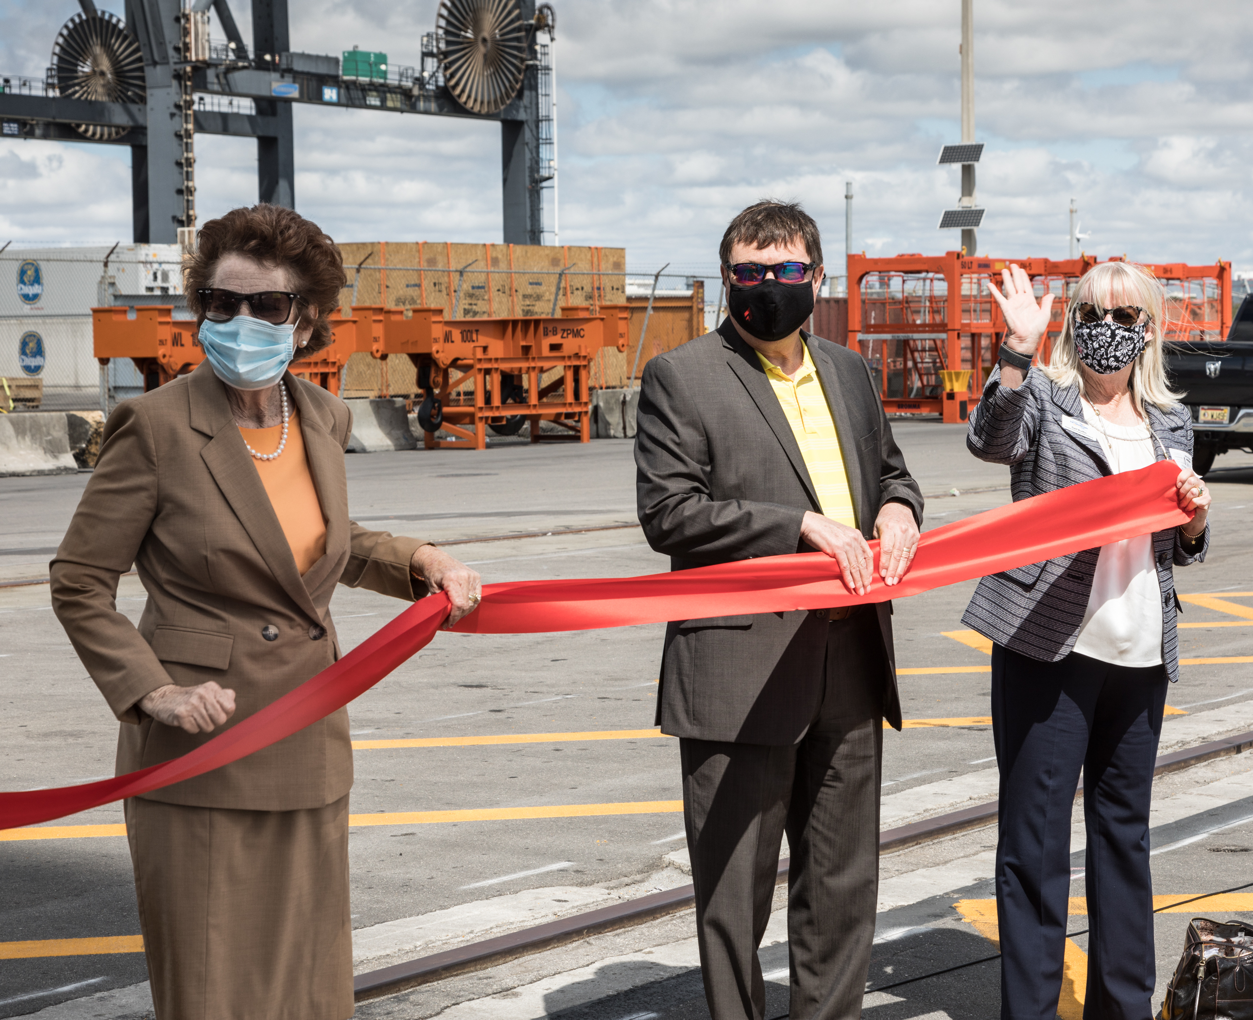
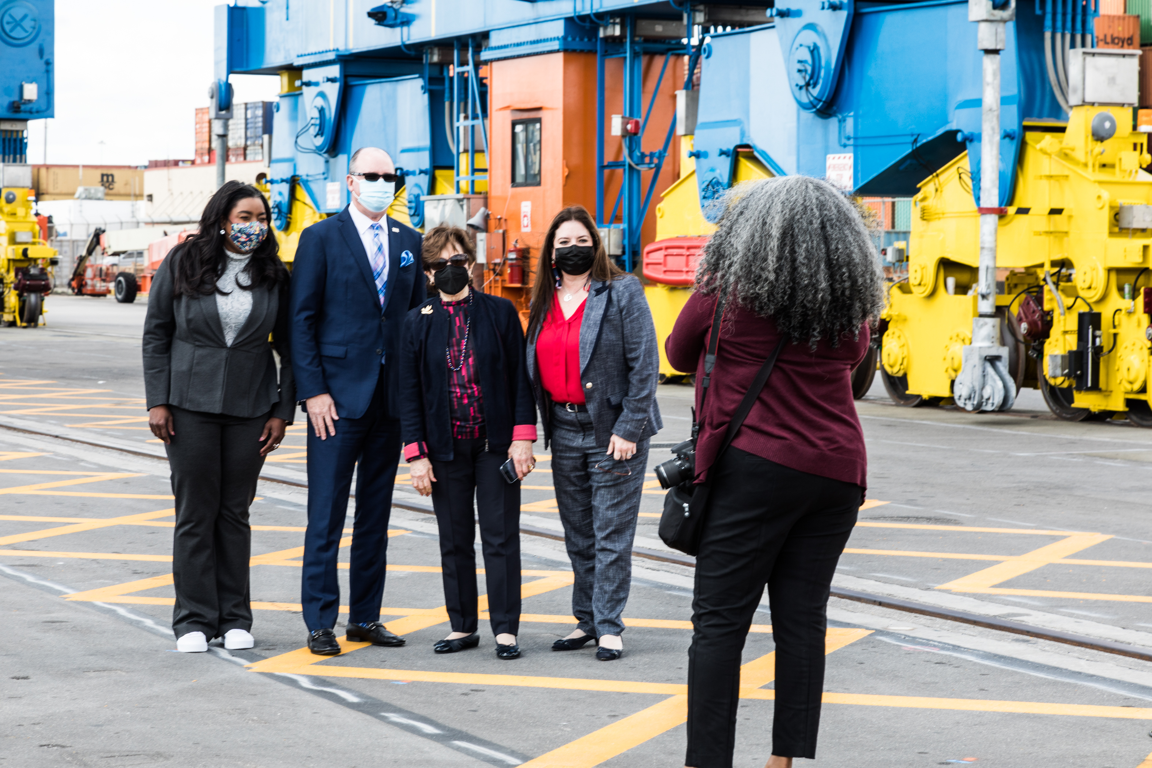
Crane Commissioning

Slide 13
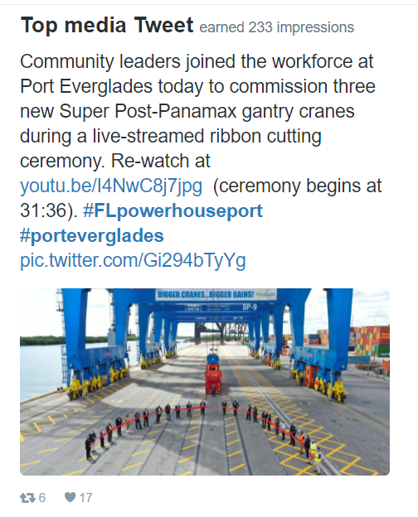
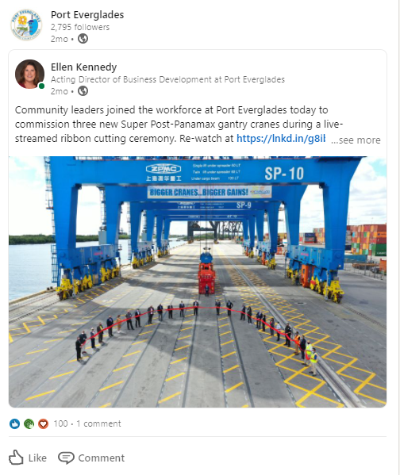
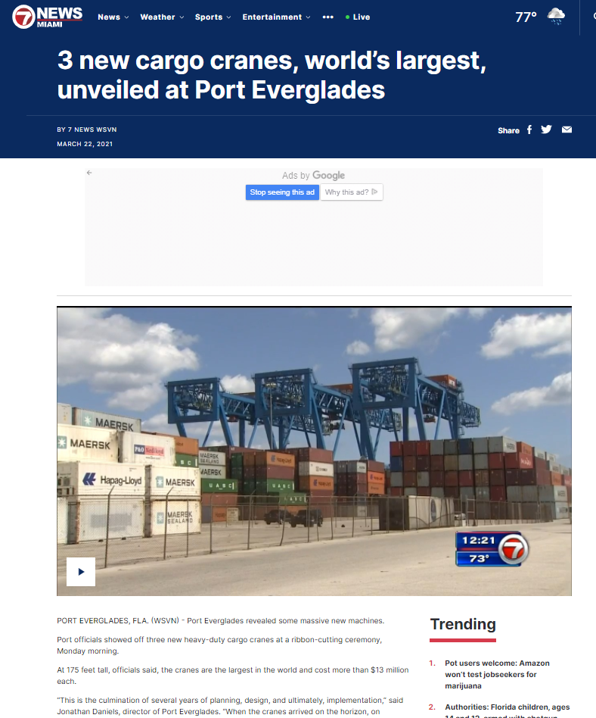
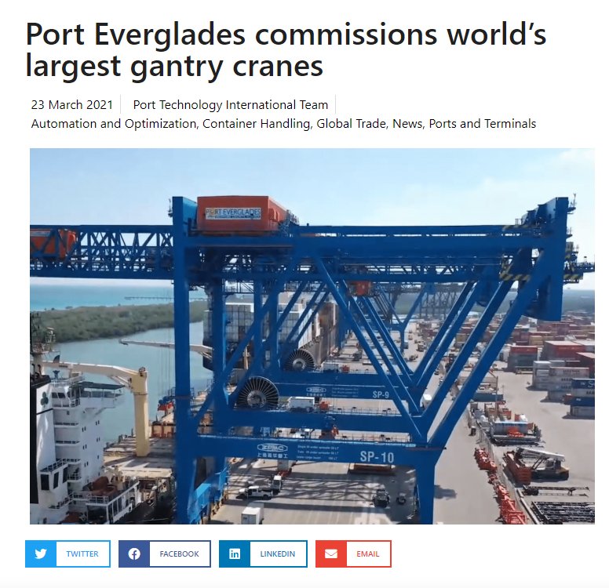
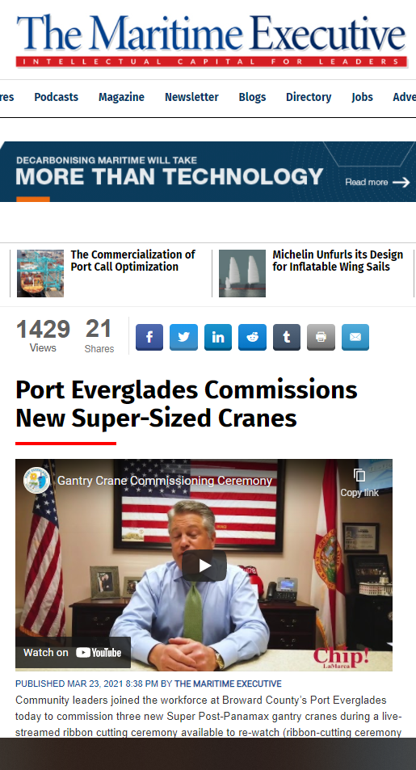
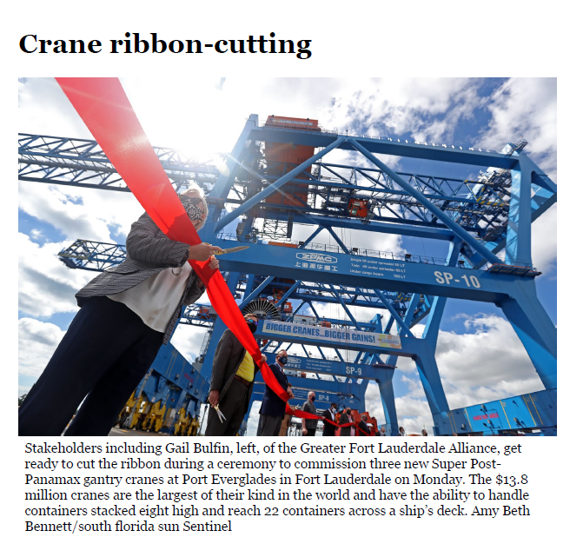

Slide 14
Strategies & Outputs
Link to live-streamed event https://www.youtube.com/watch?v=I4NwC8j7jpg&t=1428s
Link to “In Case You Missed It” video. The link was sent directly to key stakeholders via a Constant Contact invitation and posted on social media following the event, once the video was edited. https://www.youtube.com/watch?v=rQYGYSvW5qE&t=16s
Link to press release https://www.porteverglades.net/articles/post/port-everglades-commissions-new-super-sized-cranes/

Slide 15
Costs
Live-stream and video production company $8,500 (included advertising agency fees to coordinate the production)
Banner for across the crane $3,500 (installed by Port staff to save money)
Port Everglades already owned the giant bow for the first container lift, and borrowed additional ceremonial scissors from other Broward County agencies

Slide 16
Results
The largest Port Everglades event in the past drew approximately 500 people
729 views during the livestreamed event
657 views of the “In Case You Missed It” video after the event
40 participants in the congratulatory videos
25 live participants in the live-streamed ribbon cutting ceremony

Slide 17
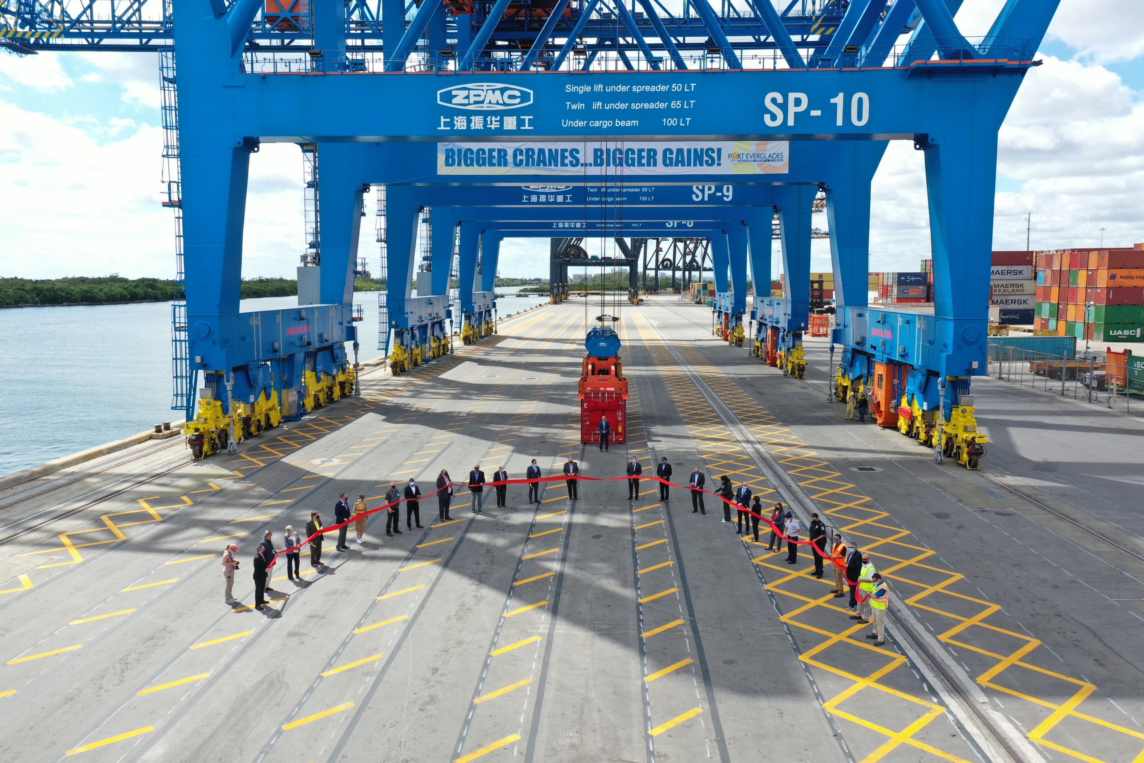
Conclusion
The virtual commissioning of three new Super Post-Panamax cranes at Port Everglades was used as a communications tool to generate excitement locally and among stakeholders. Live streaming gave the Port a stage to reach more people than could attend a live event.
The cranes are one of several large investments that Port Everglades is making to increase cargo productivity. They are also visually exciting and relatable. Everyone loves big toys!
The live-streamed event was viewed by 729 people. After the event, the Port invited stakeholders and social media viewers to watch a shorter, edited version of the congratulatory messages and the event that generated 657 views. This special event successfully raised local awareness about the Port’s economic value to the community, and garnered attention in the cargo trade about the Port’s investments to improve productivity.

