Slide 1
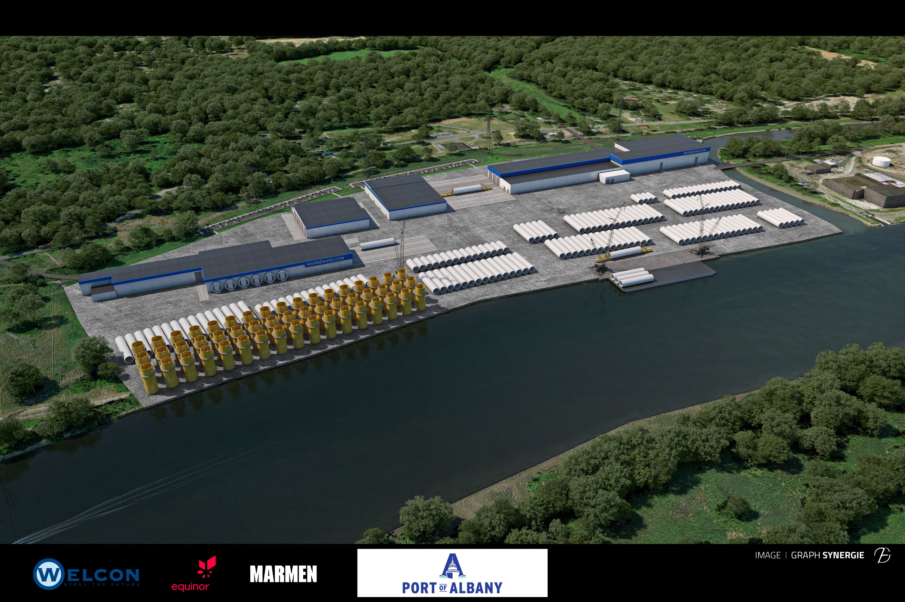
Lighthouse Awards
Port of Albany
3D Visualization for Port Expansion and Offshore Wind Attraction Site
Communications/ Video
Rendering of Newly Leased 80-acre Offshore Wind Tower Manufacturing Facility
Run time: 3:11
https://mjinc-my.sharepoint.com/:f:/p/afrosino/EuzZof-ITAhNnfRzaH6wEwcBkw_TVF9eSmDna9tyDxQvYg?e=dLL4rv

Slide 2
Lighthouse Awards
Summary:
In recent years the Port of Albany has been implementing recommendations of a growth strategy and market assessment that prioritized expansion. This would create new long term economic development opportunities for the region and beyond.
The Port purchased 80-acres adjacent to its southern border, pursued due diligence and permitting and began marketing for Port development and offshore wind supply chain development. Since the concept was so visionary, the Port worked with consulting engineers to develop a 3D visualization video to use in business development and marketing efforts to be able to convey what was possible at the site. The Port now has a development and user agreement.
Port of Albany
3D Visualization for Port Expansion and Offshore Wind Attraction Site
Communications/ Video

Slide 3
Lighthouse Awards
Overall Mission:
The Port of Albany leadership team focused on fulfilling the Port expansion and pursuing offshore wind supply chain development opportunities that require waterside access. This pursuit integrated with the Port’s mission, New York State aggressive initiative to support renewable energy and an industry need that is fast developing in the United States.
In 2021, the Port of Albany announced that it will host the first offshore wind manufacturing facility in the United States at the port expansion site.
Port of Albany
3D Visualization for Port Expansion and Offshore Wind Attraction Site
Communications/ Video

Slide 4
Lighthouse Awards
Planning & Programming:
Objective: Develop a marketing piece to convey the vision and highlight the possibilities of developing the 80-acres.
It is currently a forested, vacant site. The 3D video was determined to be the most effective way to market the property to convey the vision and possibilities, including to overseas companies.
Primary Audiences: The primary target was global offshore wind supply chain companies, specifically developers and manufacturing companies.
Secondary Audiences: This tool is useful for resource development as well as conveying the vision to local and regional leaders, community groups and media.
Port of Albany
3D Visualization for Port Expansion and Offshore Wind Attraction Site
Communications/ Video

Slide 5
Lighthouse Awards
Actions & Outputs:
The Port of Albany utilized McFarland Johnson Consulting Engineers who were completing the site environmental and engineering work, to coordinate graphics and design team to develop the 3D visualization tool for marketing purposes.
The strategy was to help customers visualize the transformation of wooded, vacant land into a hub of offshore wind manufacturing and how it would tie in with the shipping of components along the Hudson River as well as the traffic flow of trucks and vehicles and personnel to the facility.
The Port focused on showing the commitment and foresight it had in developing this groundbreaking project in the United States by creating the opportunity.
Port of Albany
3D Visualization for Port Expansion and Offshore Wind Attraction Site
Communications/ Video

Slide 6
Lighthouse Awards
Actions & Outputs (continued):
The total cost of this marketing effort was under $20,000.
The effort was successful. New York State’s Governor announced in his 2021 State of the State address an historic offshore wind investment by Equinor, Marmen and Welcon at the Port of Albany as the first offshore wind tower manufacturing site in the nation.
The project will transform the Port’s 80-acre expansion site into a world class manufacturing facility and maritime operation. The project will also develop land in the Port’s existing district and utilize recently improved maritime enhancements to support this endeavor. This 3D visualization is being update to depict the actual planned operations.
Port of Albany
3D Visualization for Port Expansion and Offshore Wind Attraction Site
Communications/ Video

Slide 7
Lighthouse Awards
Actions & Outputs (continued):
A joint venture between Marmen and Welcon with partner Equinor Wind US LLC will operate the entirety of the project site where they will fabricate offshore wind towers in just over 600,000 square feet of new manufacturing space. The project is in design, engineering and permitting and construction will begin in 2022. The construction of the facilities and development of the site is expected to create 500 jobs. Once complete, the project will create 350 full-time, long term jobs and is creating a hub of offshore wind supply chain interest in and around the Port of Albany, New York.
Port of Albany
3D Visualization for Port Expansion and Offshore Wind Attraction Site
Communications/ Video

